Slide 1
GPT의 이해
GPTGenerativePre-trainedTransformer

Slide 2
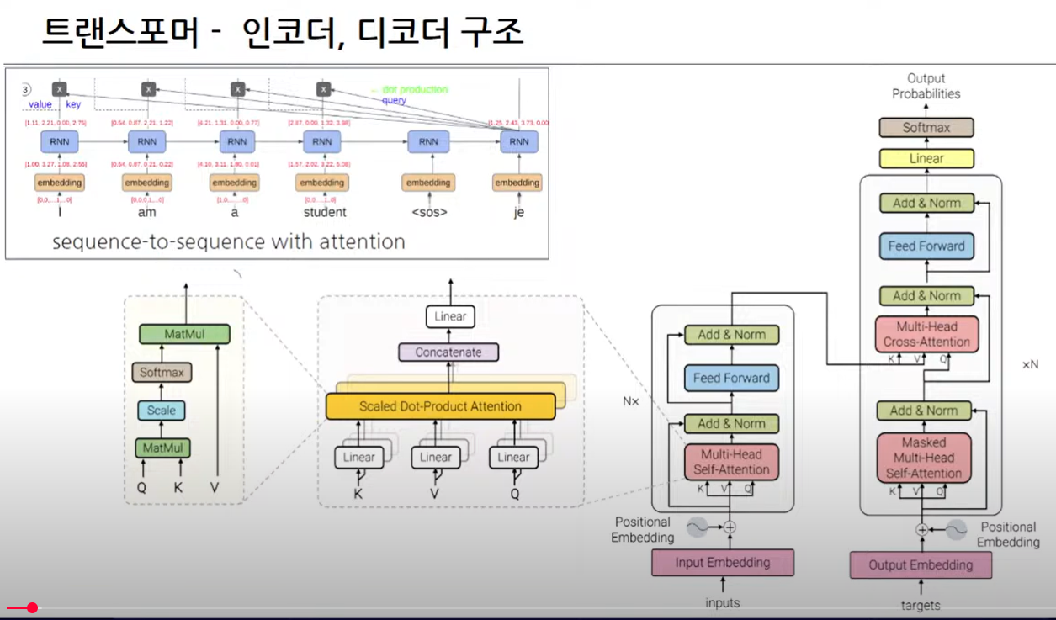

Slide 3
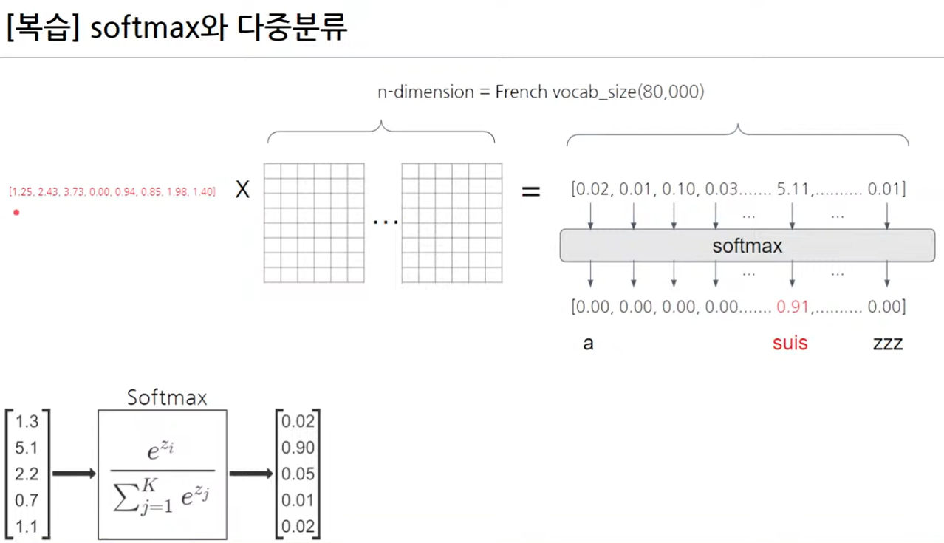

Slide 4
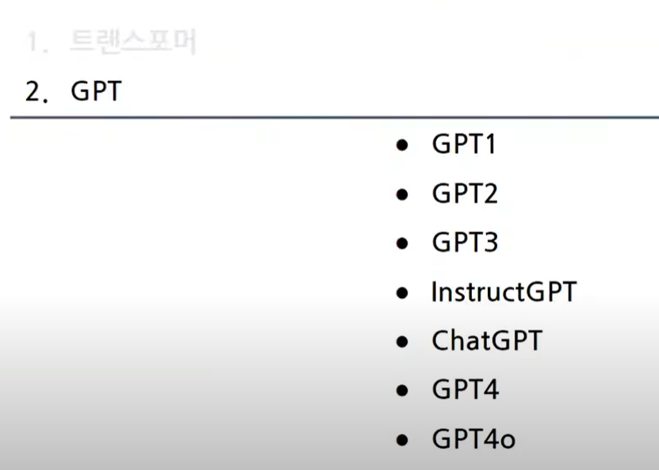

Slide 5
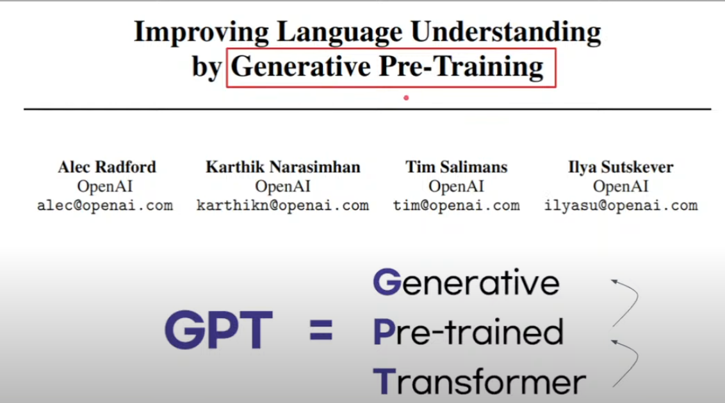

Slide 6
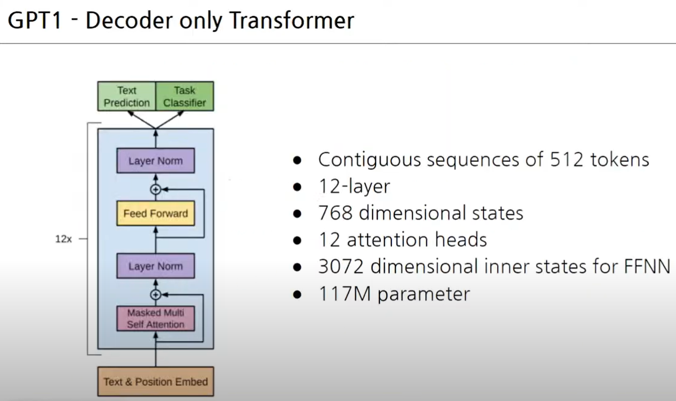

Slide 7
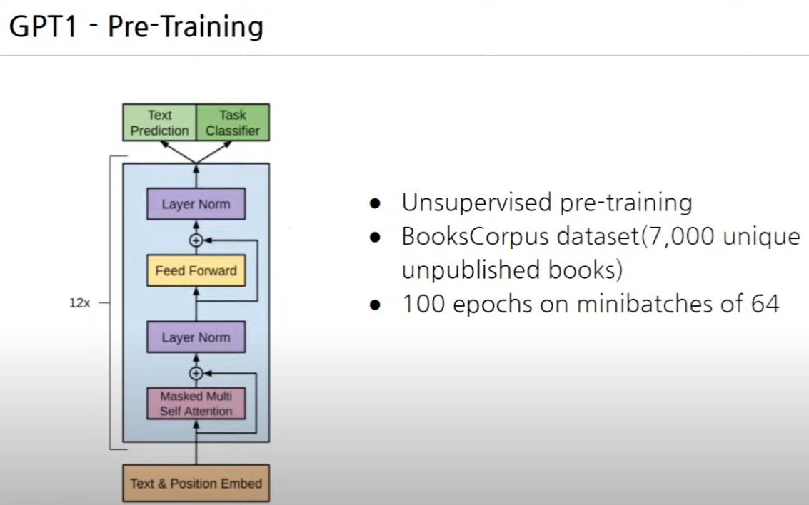

Slide 8
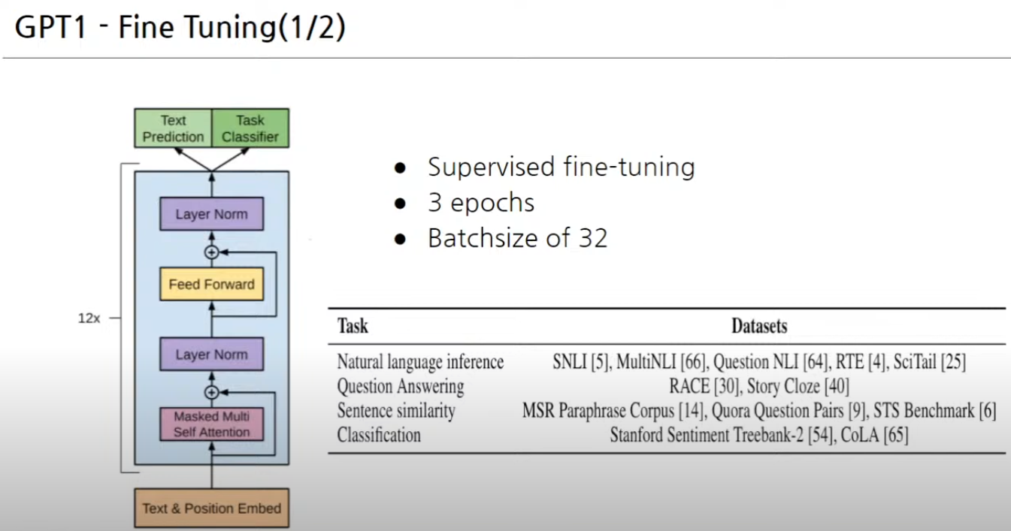

Slide 9
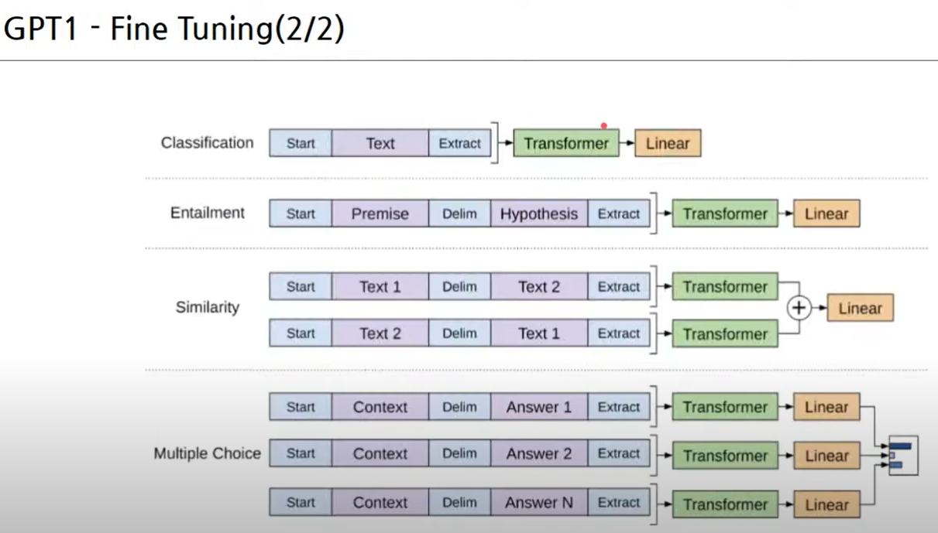

Slide 10
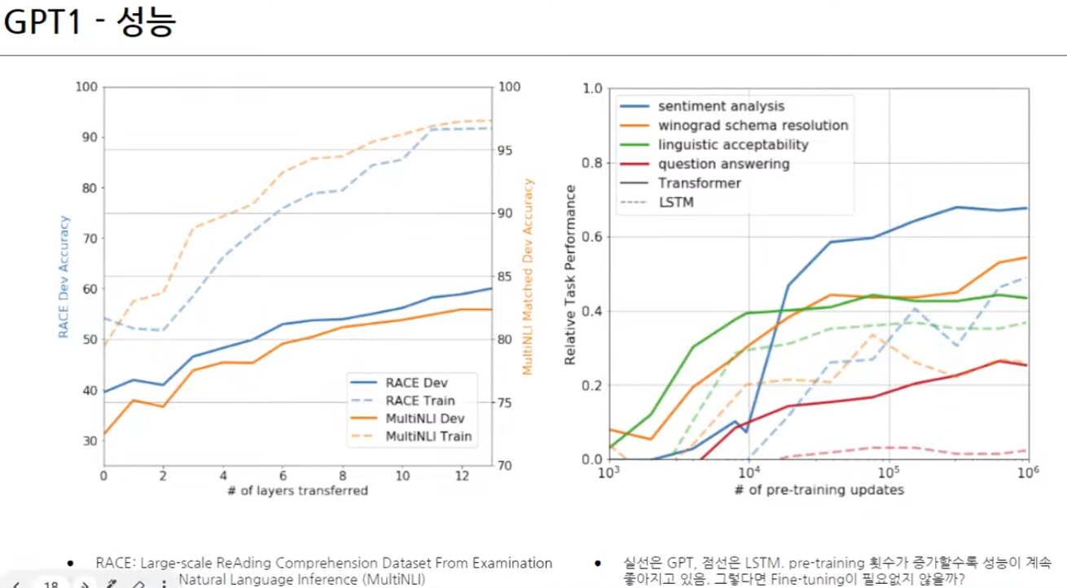

Slide 11
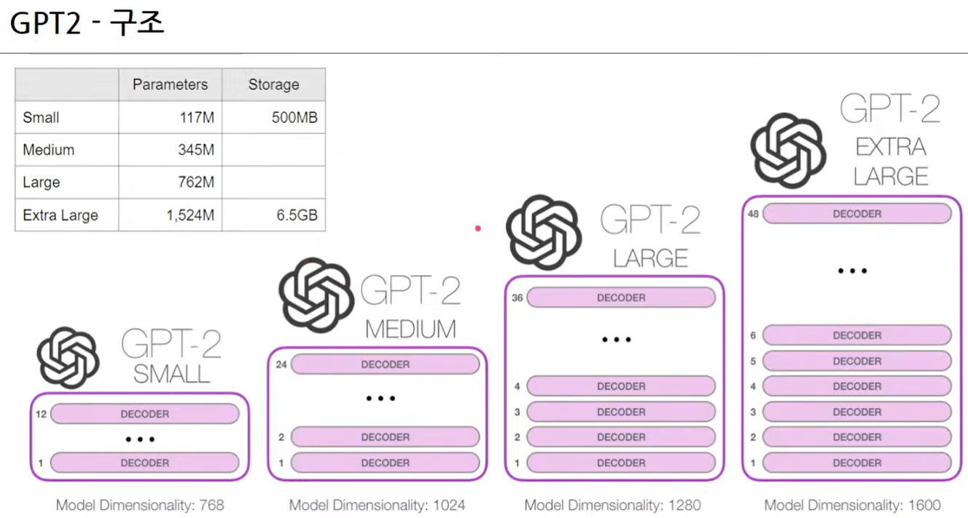

Slide 12
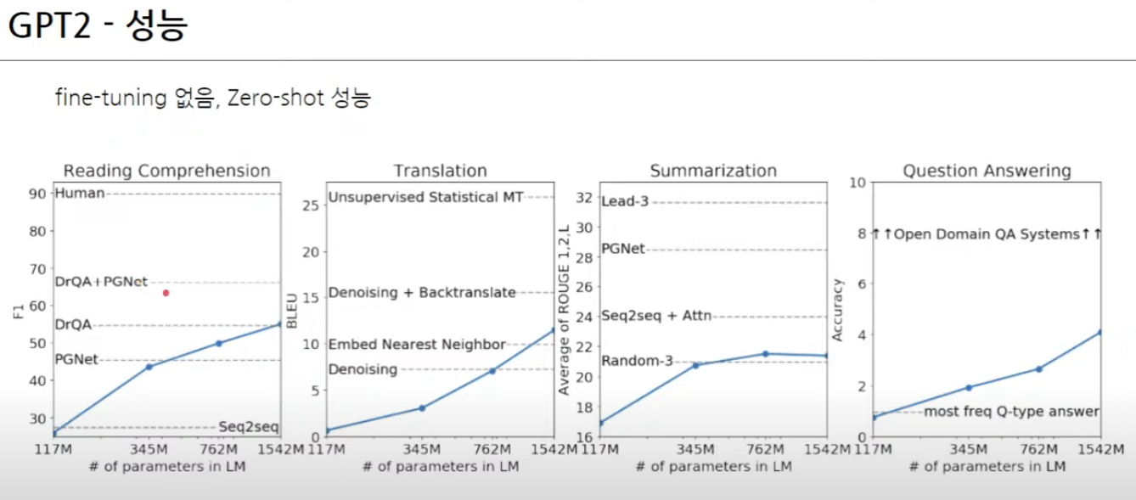

Slide 13
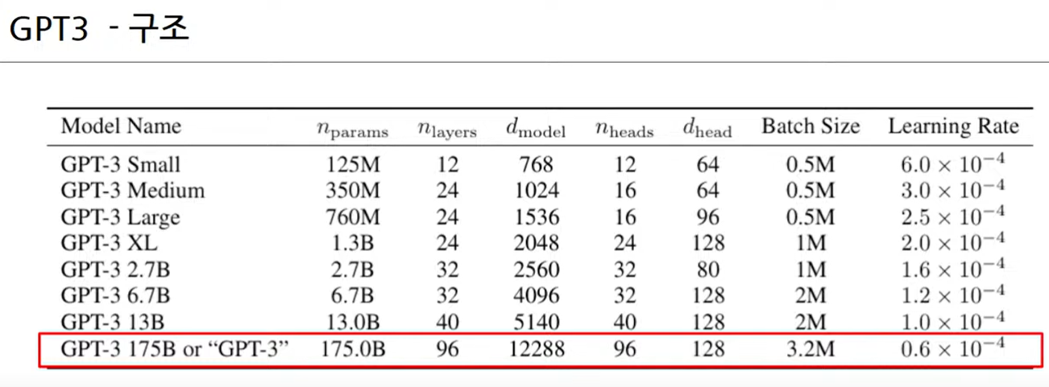

Slide 14
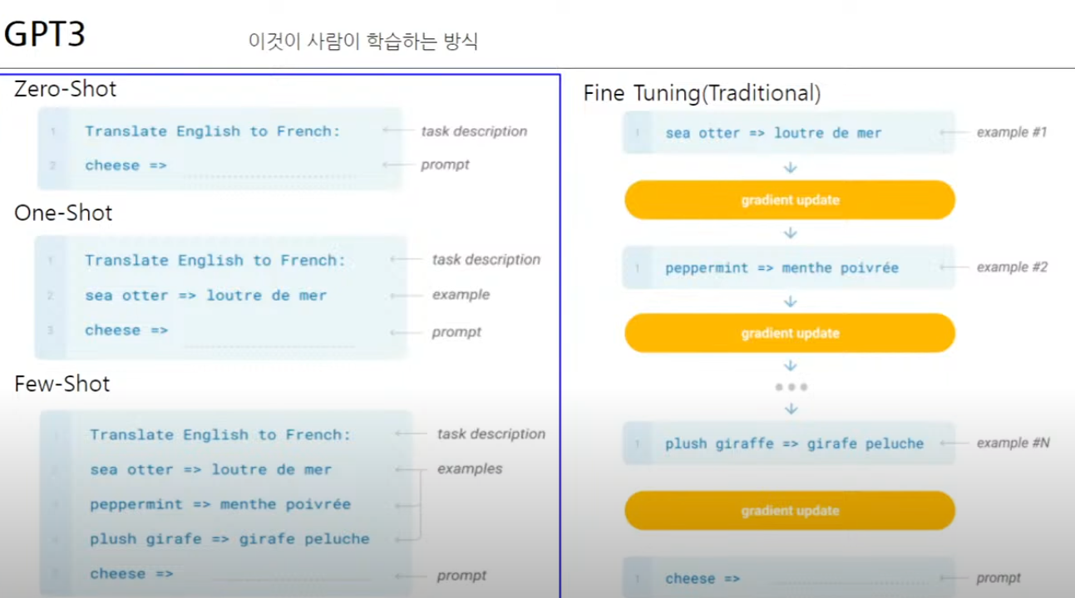

Slide 15
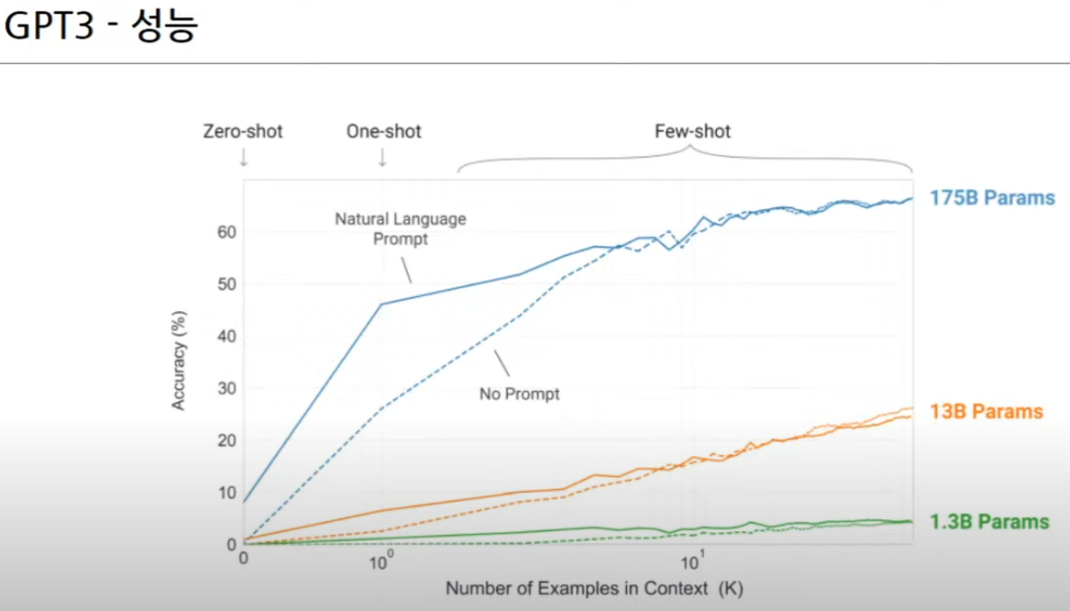

Slide 16
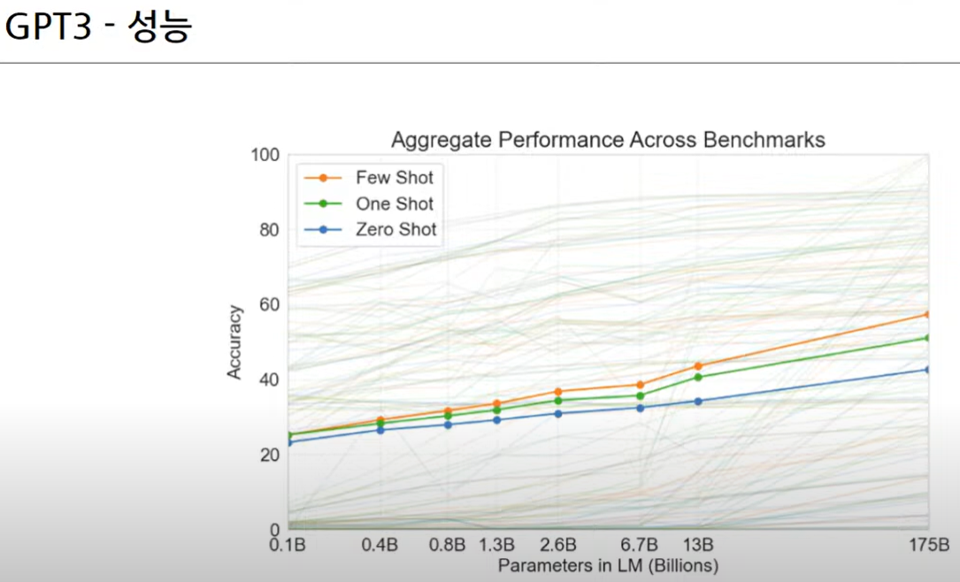

Slide 17
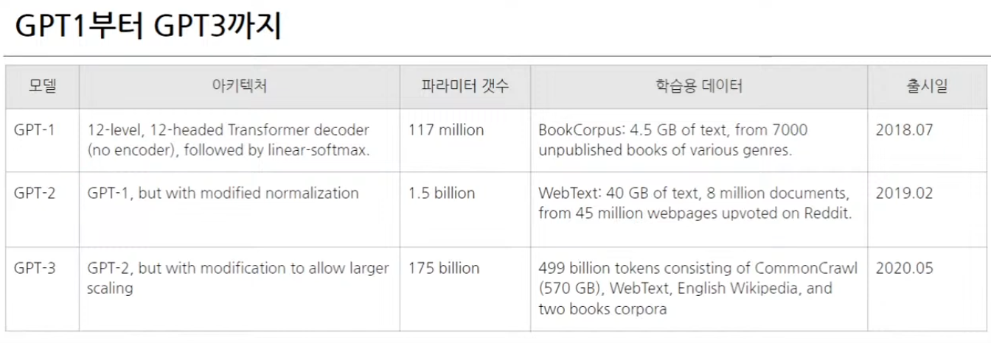
GPT1부터 GPT3까지모델GPT-1GPT-2아키텍처12-level, 12-headed Transformer decoder(no encoder), followed by linear-softmax.GPT-1, but with modified normalization파라미터 갯수117 million1.5 billion2019.02GPT-3GPT-2, but with modification to allow largerscaling175 billion학습용 데이터BookCorpus: 4.5 GB of text, from 7000unpublished books of various genres.WebText: 40 GB of text, 8 million documents,from 45 million webpages upvoted on Reddit.499 billion tokens consisting of CommonCrawl(570 GB), WebText, English Wikipedia, andtwo books corpora출시일2018.072020.05

Slide 18
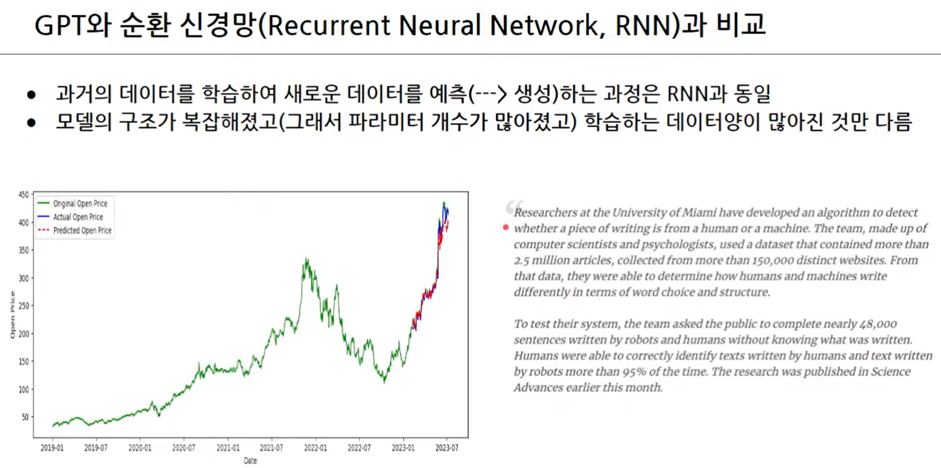

Slide 19
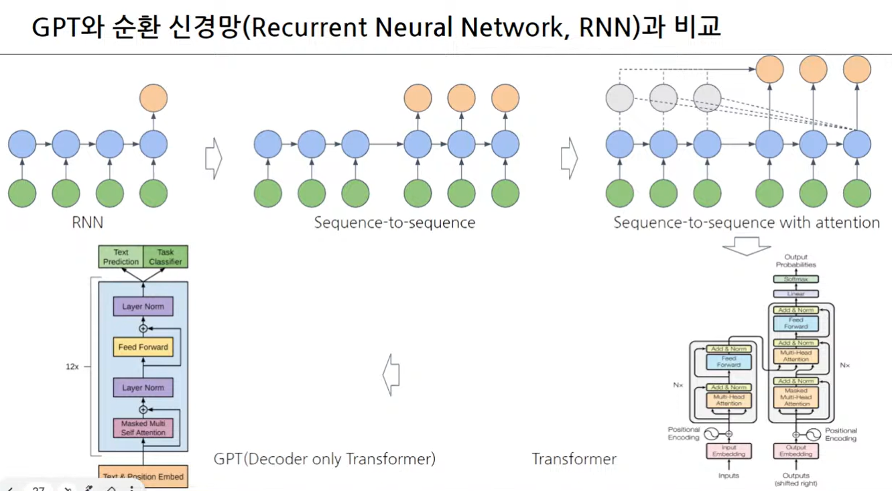

Slide 20
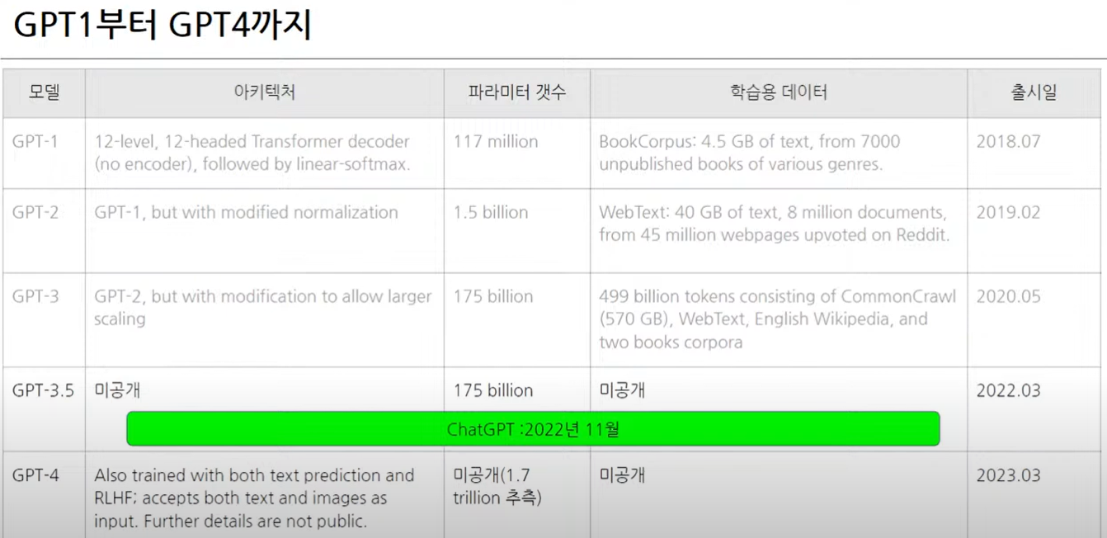

Slide 21
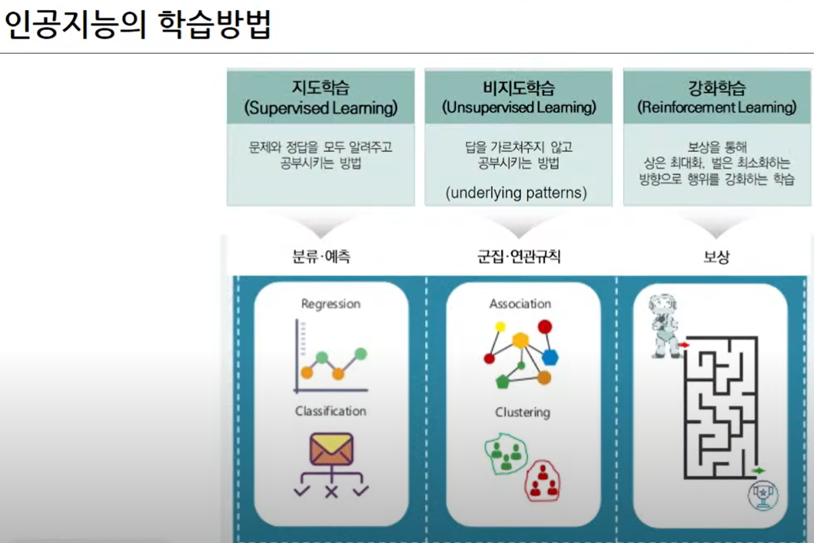

Slide 22
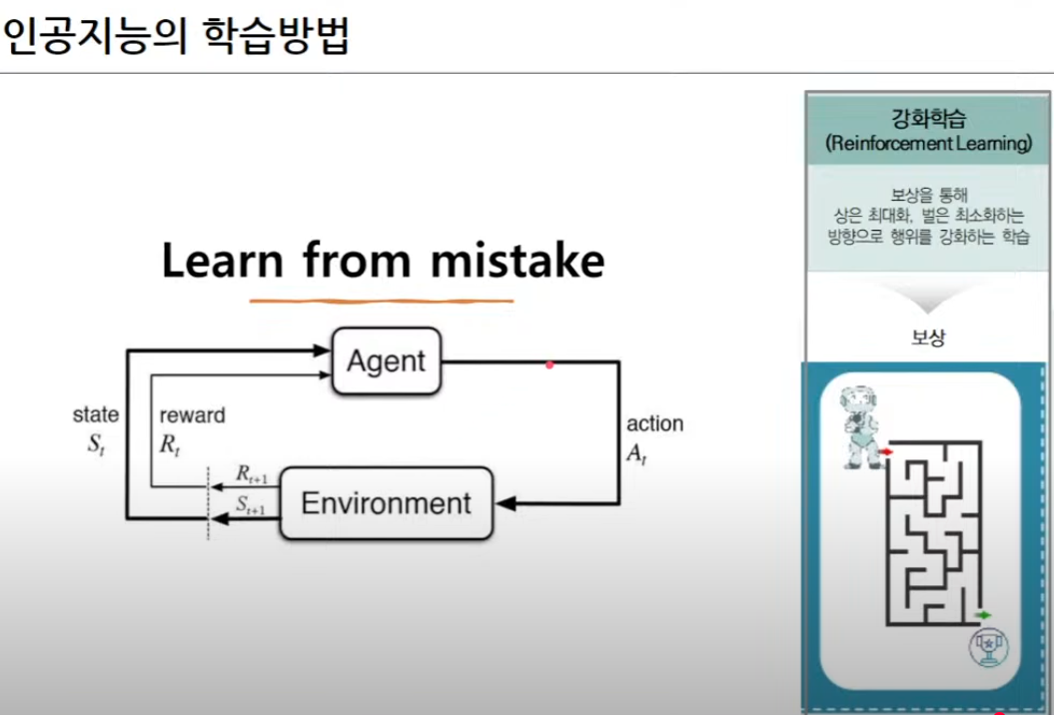

Slide 23
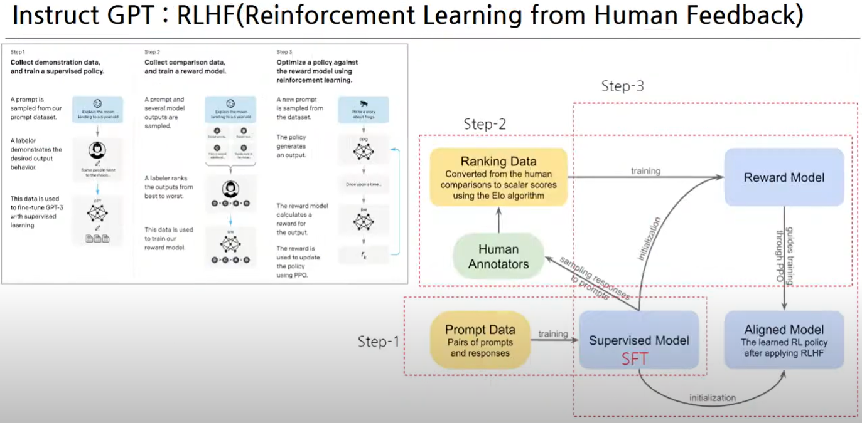

Slide 24
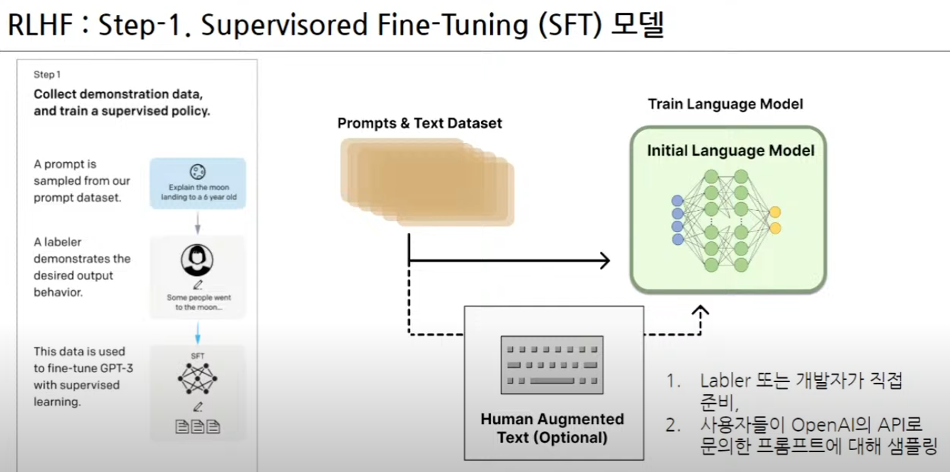

Slide 25
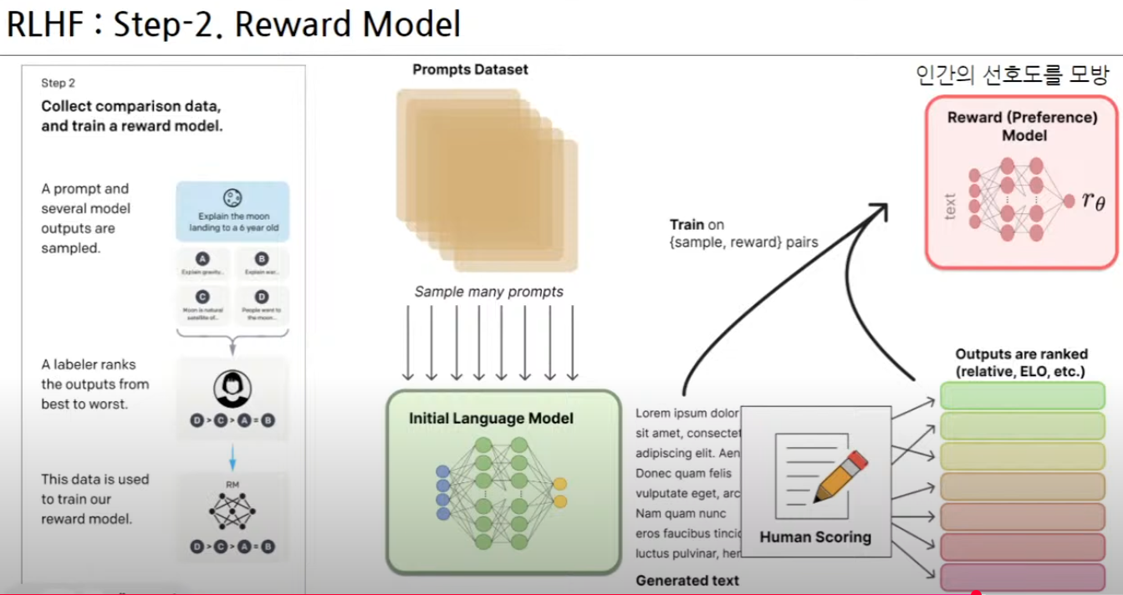

Slide 26
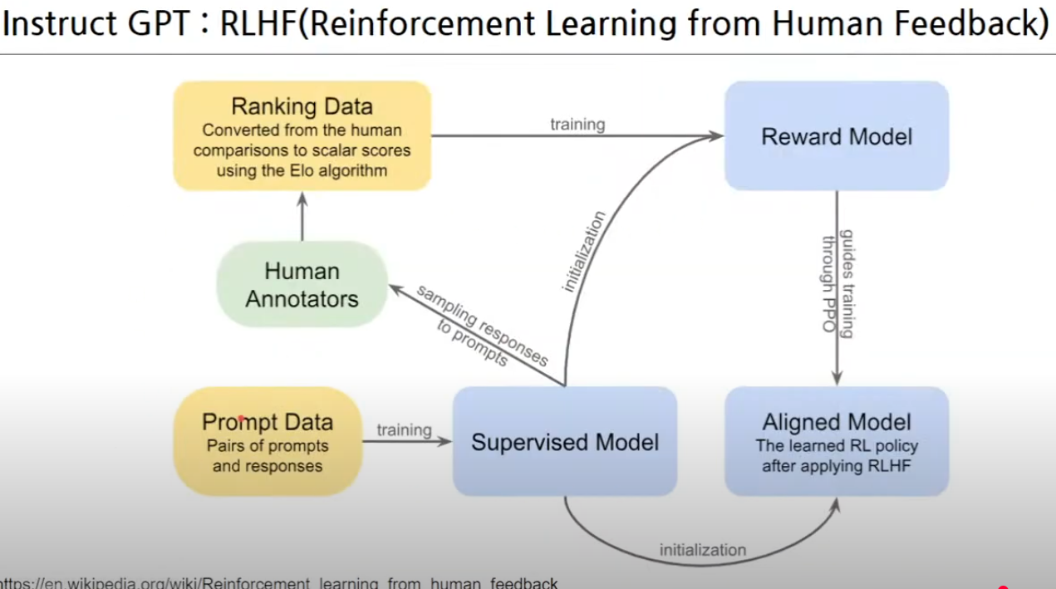

Slide 27
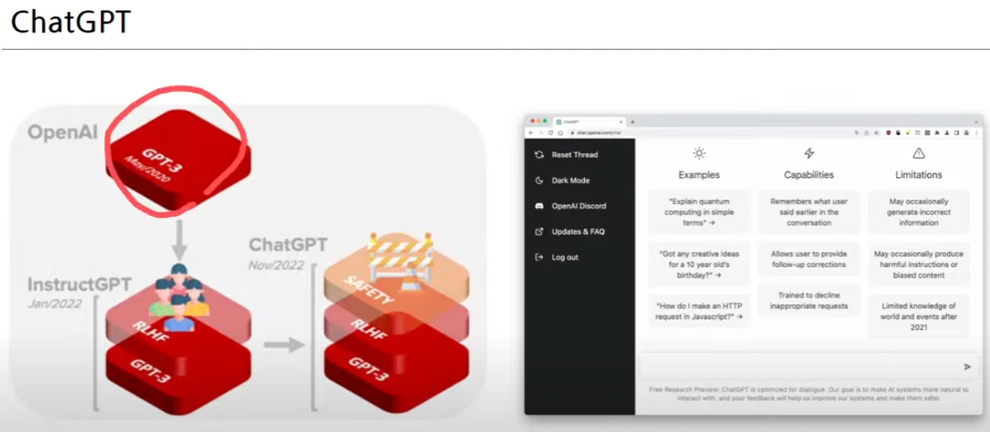

Slide 28
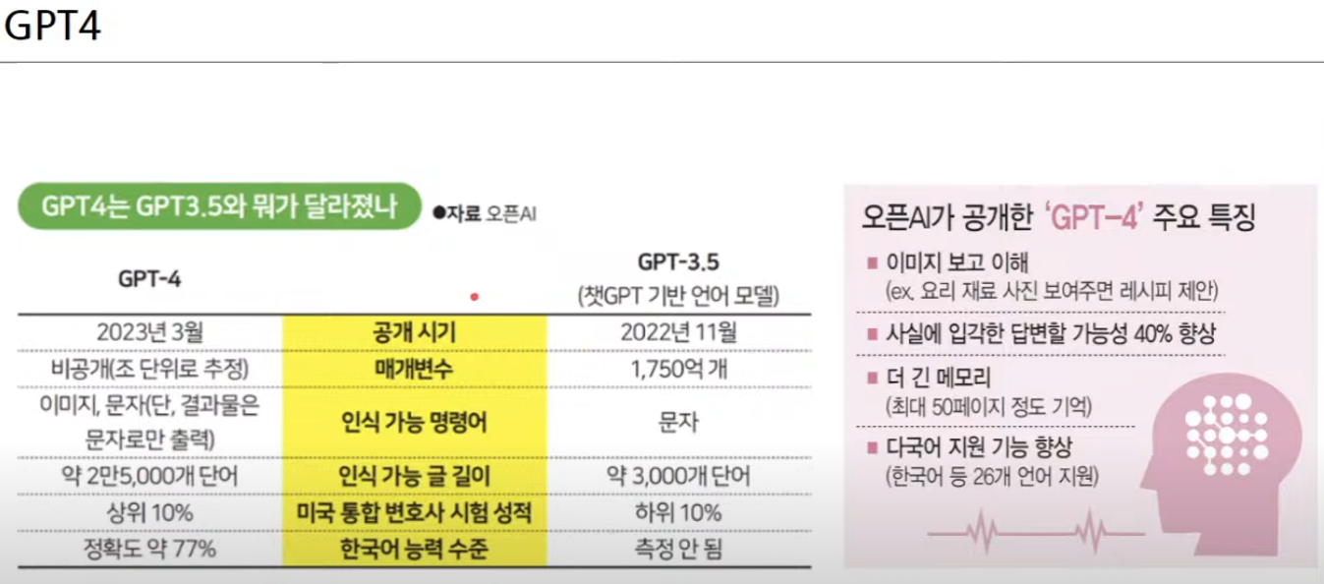

Slide 29
